Slide 1
BRAND DNA

Slide 3
From the military uniform to the fetish jacket of the young & reckless, the Bomber jacket has been constantly reinvented without ever losing any of its appeal. A tribute to history that Bombers Original® has made a point of celebrating since its creation.
Led for several years now by an experienced and multicultural team, the eponymous “flight jacket” brand has naturally established itself as the worldwide reference, thanks to its timeless and unmistakable designs.
Since its creation in the 1950s, this emblematic jacket has made it through the years without showing a wrinkle. Designed to satisfy technical needs rather than stylistic desires, the "MA-1" and "B15" models were initially developed for US navy and air force fighter pilots.
Its original characteristics: warm to cope with cold temperatures, outside and inside a cockpit; short to avoid getting stuck on the ejector seat; lined with orange nylon to make it more visible in case of a crash; and finally, equipped with its famous zipped pocket on the sleeve for placing cards and pens. Success on a much larger scale was unexpected as these “flight jackets” quickly became real objects of desire.
Always on trend, never out-of-style and marketed for the general public, the Bomber jacket's popularity soared. To the point where the most divergent cultures became enamoured of it and turned it into a mark of identity. Popular with Mods, Vietnam veterans and Punks, as well as Hollywood's brightest stars such as James Dean, Tom Cruise in Top Gun and Steve McQueen, the jacket also makes its way into the hip-hop world thanks to Dr. Dre and 2Pac.
Although the Bomber jacket has seen a variety of novel proportions, as creators have, and continue, to remodel it, it’s the original and now cult form that Bombers Original® wants to perpetuate. A purist design, a padded lining, a zipped pocket on the sleeve, ribbed cuffs and waist. A winning formula that has earned this jacket the status of a fashion icon to which Bombers Original® will remain ever faithful.
Today, the brand plays the versatility card and juggles between plain and camouflage, nylon and velvet, street-wear codes and sophistication, virility and androgeneity. It reinvents itself throughout the seasons and creates stylish pieces that flirt with trends, while preserving the traditional details of American army-wear and work-wear. Each collection combines passion and know-how through models designed for men and women from all walks of life (and even for little ones).
The brand has also broadened its offer by offering most of the iconic American army models, in a revisited vintage version (aviators' jackets, field jackets, deck jackets, parkas, etc...) where fabrics and finishes are more than ever of the highest quality. As for the Bombers Original® story, it's not about to end any time soon.

Slide 4
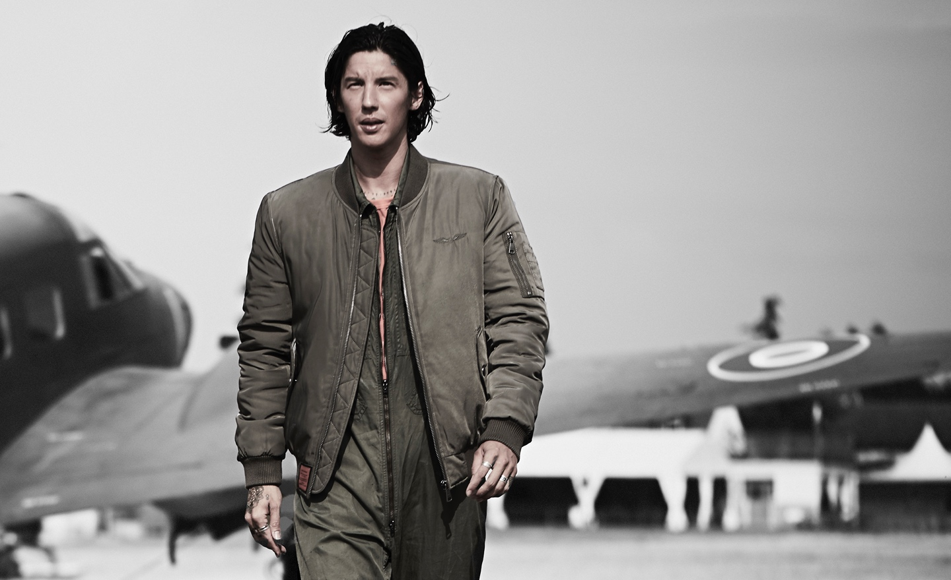
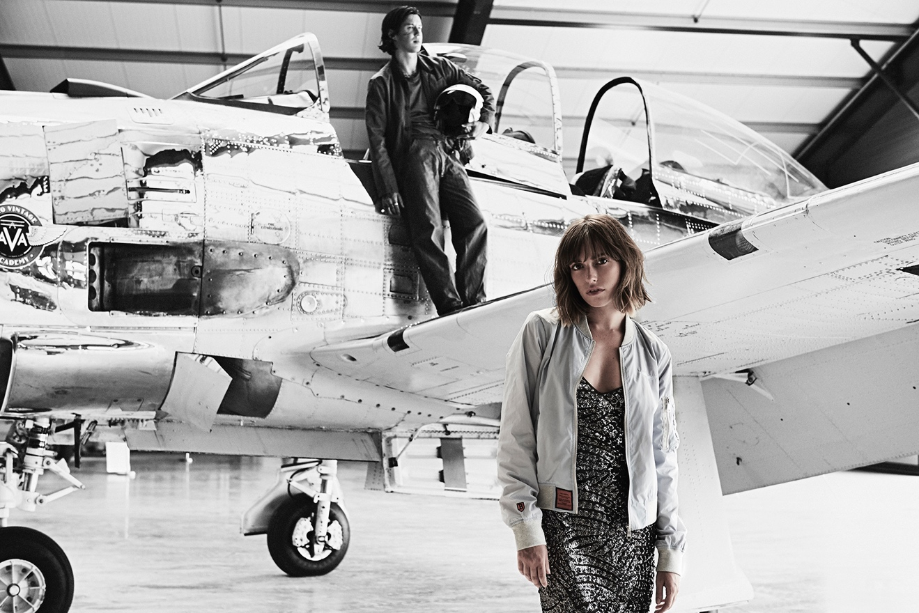
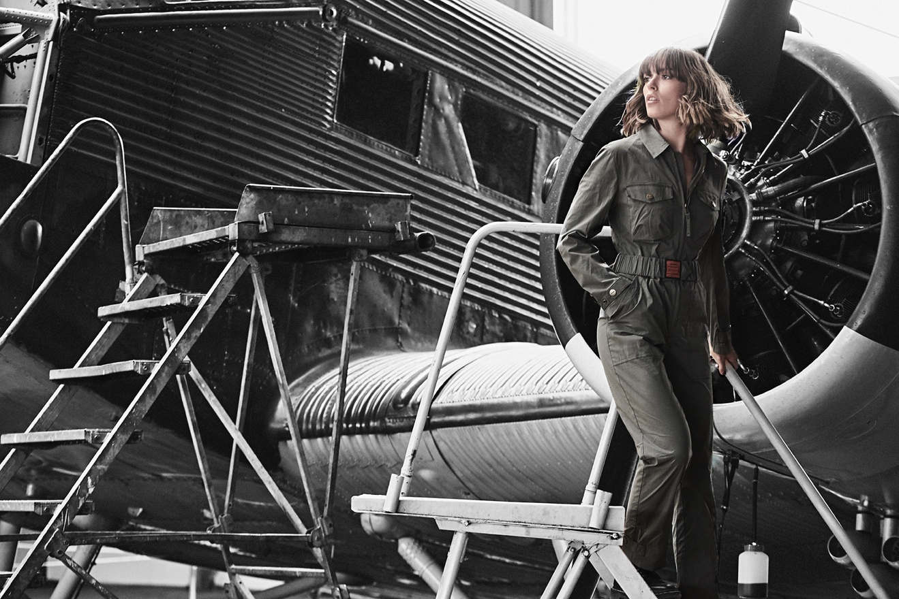

Slide 5
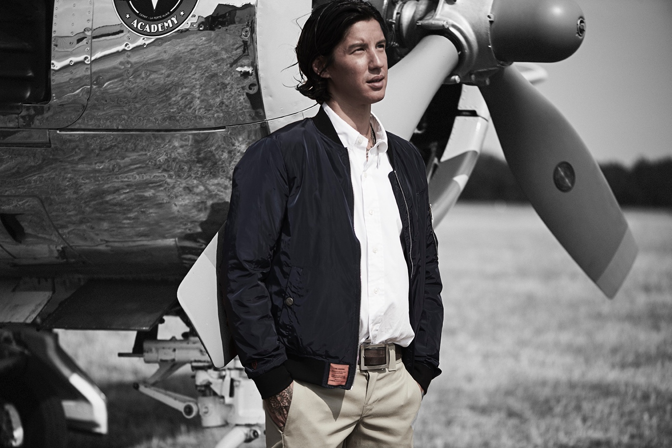

Slide 6
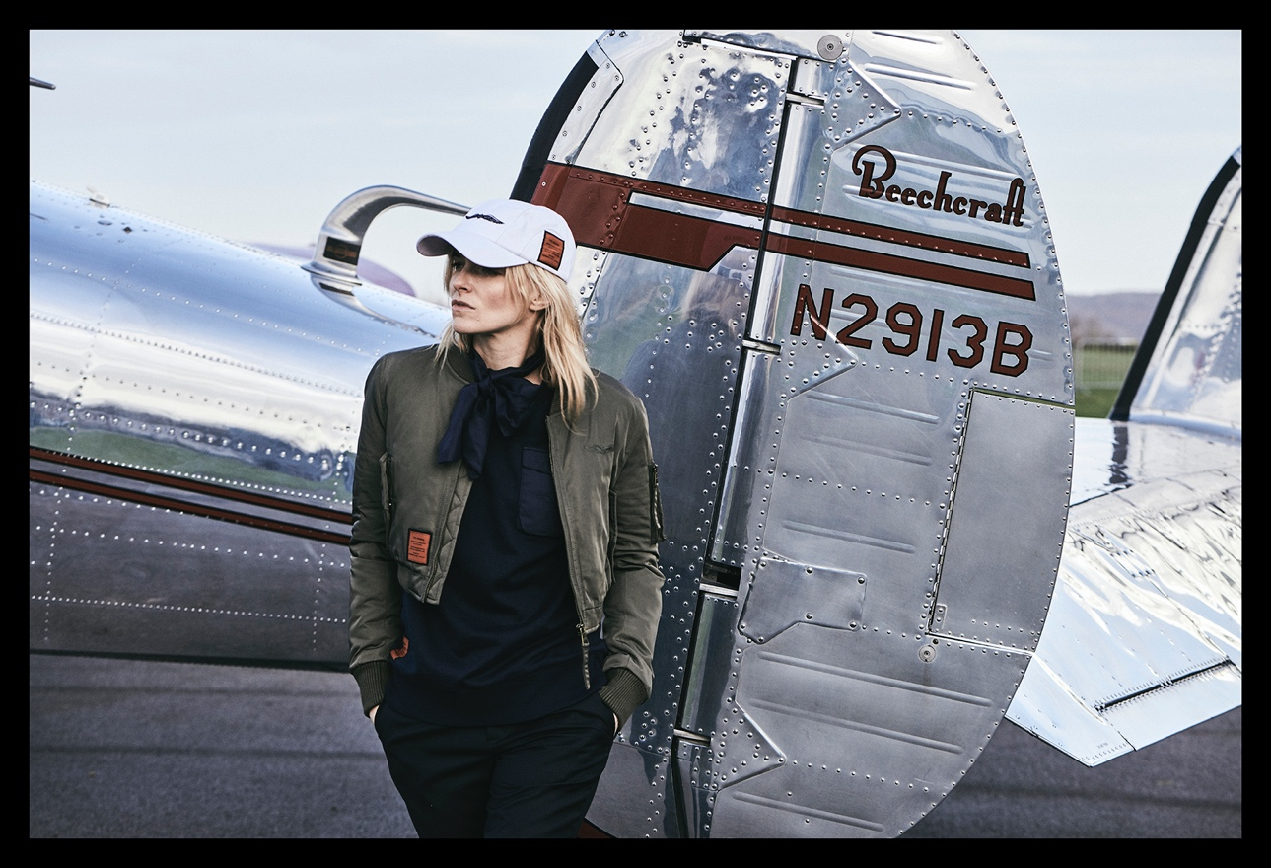

Slide 7
